Slide 1


Introduction to HydroServer and the Observations Data Model (ODM)
CUAHSI
HIS
Sharing hydrologic data
http://his.cuahsi.org/
Jeffery S. Horsburgh
Utah Water Research Laboratory
Utah State University
Support
EAR 0622374

Slide 2
CUAHSI HIS
The CUAHSI Hydrologic Information System (HIS) is an internet based system to support the sharing of hydrologic data. It is comprised of hydrologic databases and servers connected through web services as well as software for data publication, discovery and access.
Data Discovery and Integration platform
HIS Central
Like search portals Google, Yahoo, Bing
Metadata Services
Metadata Search
Service registration
Service and data theme metadata
Catalog harvesting
Data carts
HydroServer
Data Services
HydroDesktop
Data Publication platform
Water Data Services
Data Synthesis and Research platform
Spatial Data Services
Like web servers
Like HTML
Like browsers

Slide 3
HydroServer Goals
A platform for organizing and publishing space-time hydrologic datasets that:
Provides local control of data
Makes data universally available
Is autonomous – e.g., functional independent of the rest of HIS

Slide 4
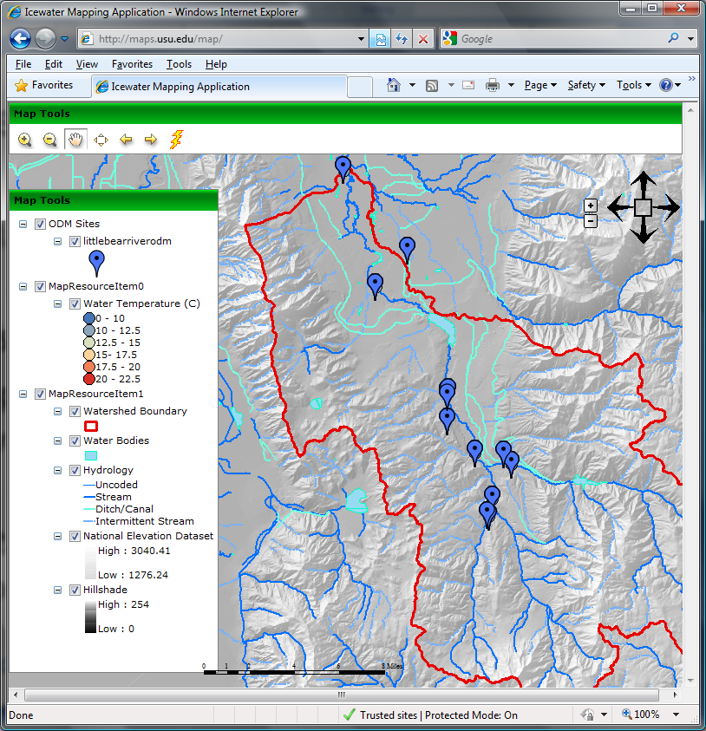
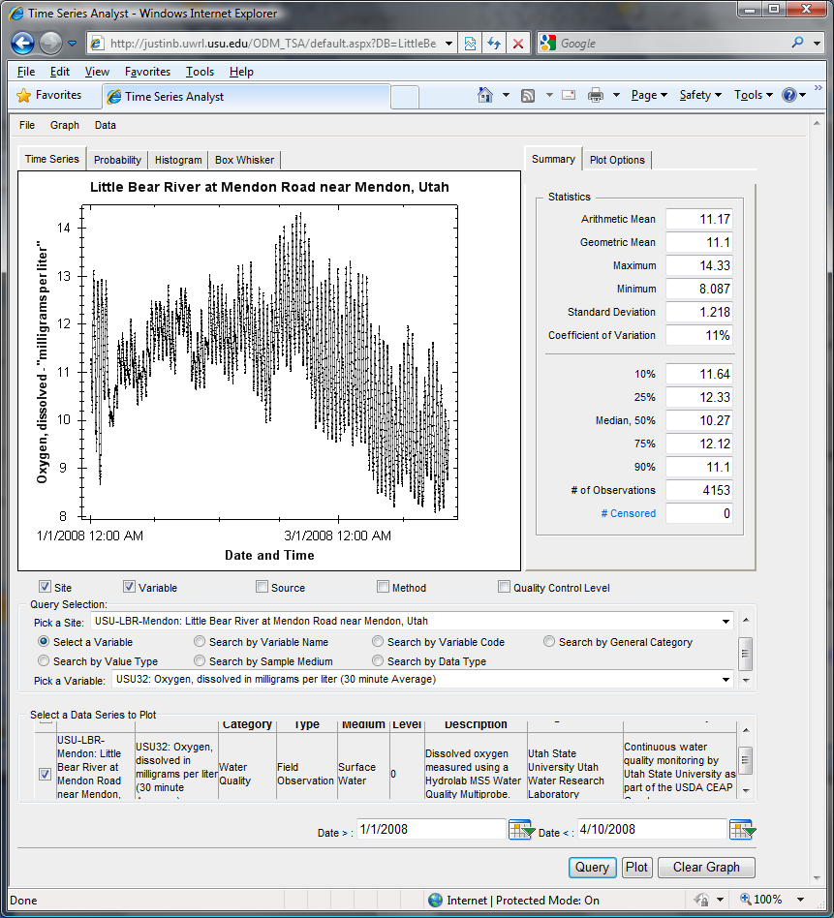
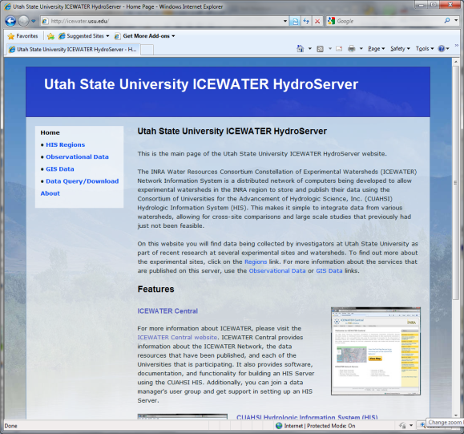
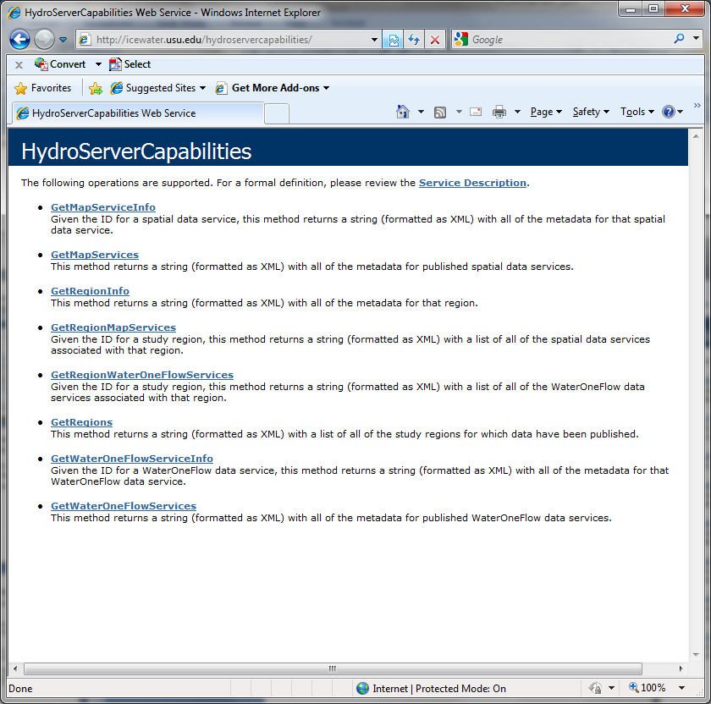
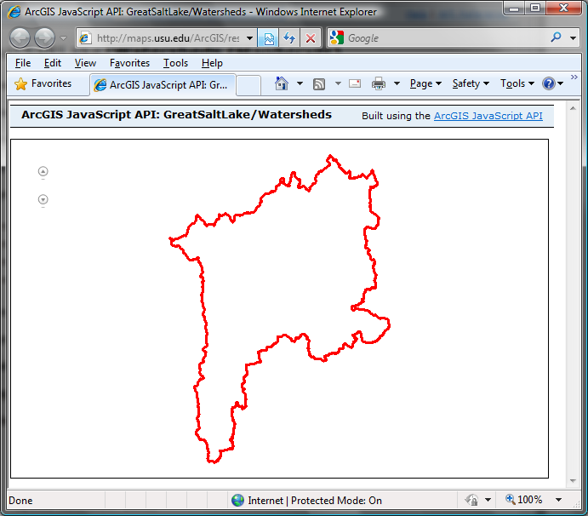
Capabilities Database Configuration Tool
WaterOneFlow
Services
HydroServer
Capabilities
Database
Spatial
Services
WaterOneFlow
WaterOneFlow
WaterOneFlow
ODM
ODM
ODM
ODM Databases and Web Services
ArcGIS Server Spatial Data Services

Slide 5
HydroServer Regions
A region is an experimental watershed, research site, etc. for which data are published
Little Bear River Experimental Watershed
Reynolds Creek Experimental Watershed
T.W. Daniels Experimental Forest
Organizing concept for HydroServer
One or more ODM databases/WaterOneFlow services for a region
One or more geospatial data services for a region

Slide 6
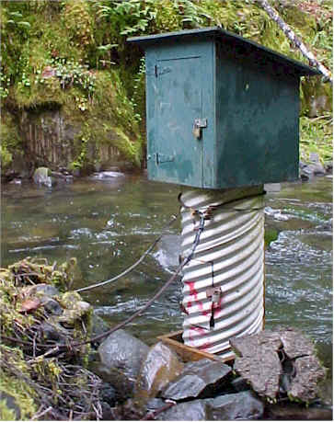
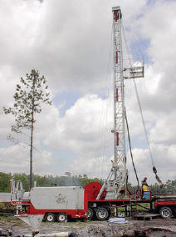
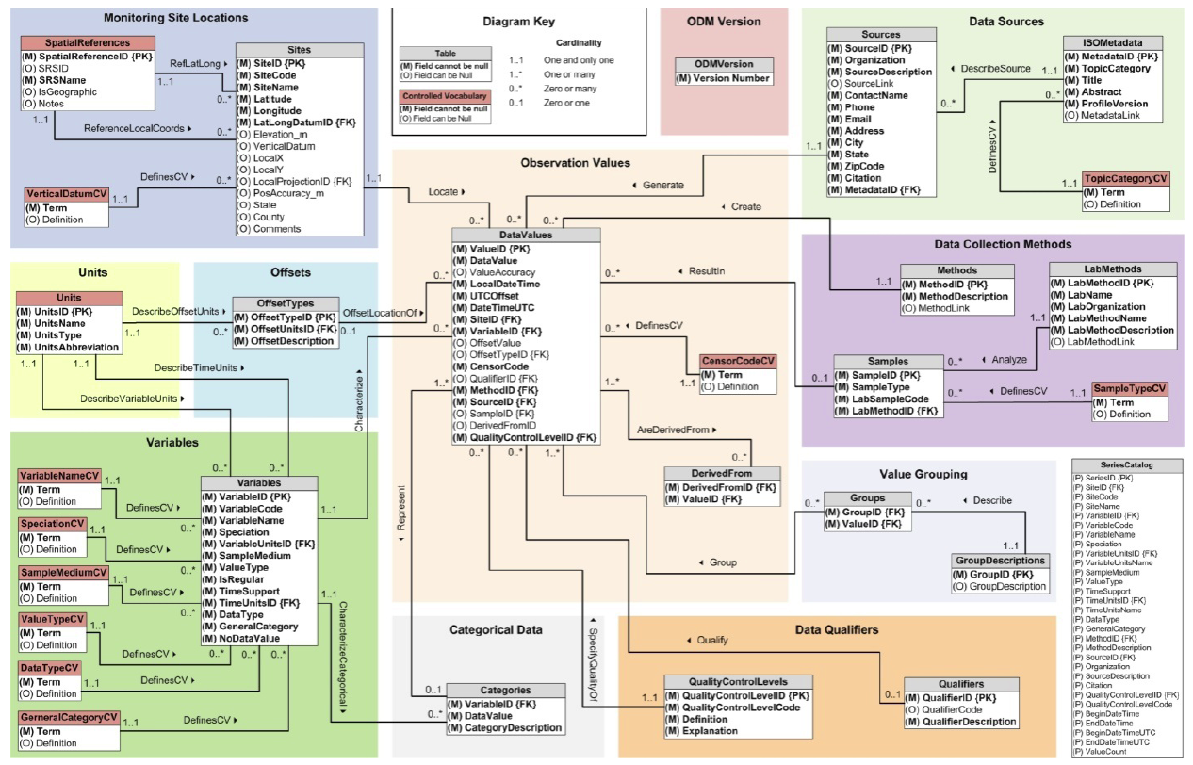
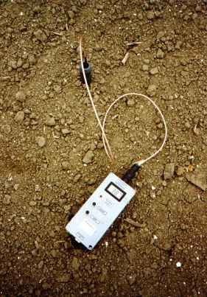
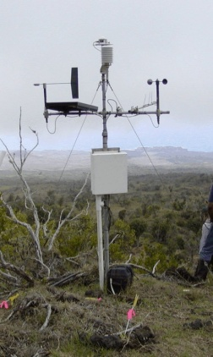
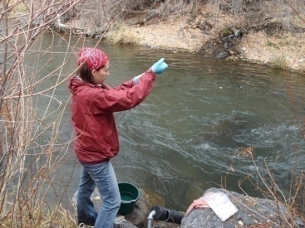
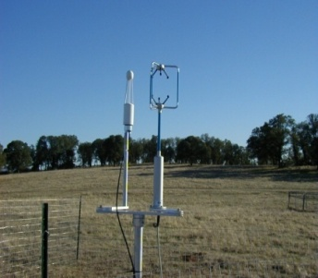
Observations Data Model (ODM)
Streamflow
Groundwater
levels
Precipitation
& Climate
Soil
moisture
data
Water Quality
Flux tower data
A relational database at the single observation level
Metadata for unambiguous interpretation
Traceable heritage from raw measurements to usable information
Promote syntactic and semantic consistency
Cross dimension retrieval and analysis
Horsburgh, J. S., D. G. Tarboton, D. R. Maidment, and I. Zaslavsky (2008), A relational model for environmental and water resources data, Water Resources Research, 44, W05406, doi:10.1029/2007WR006392.

Slide 7
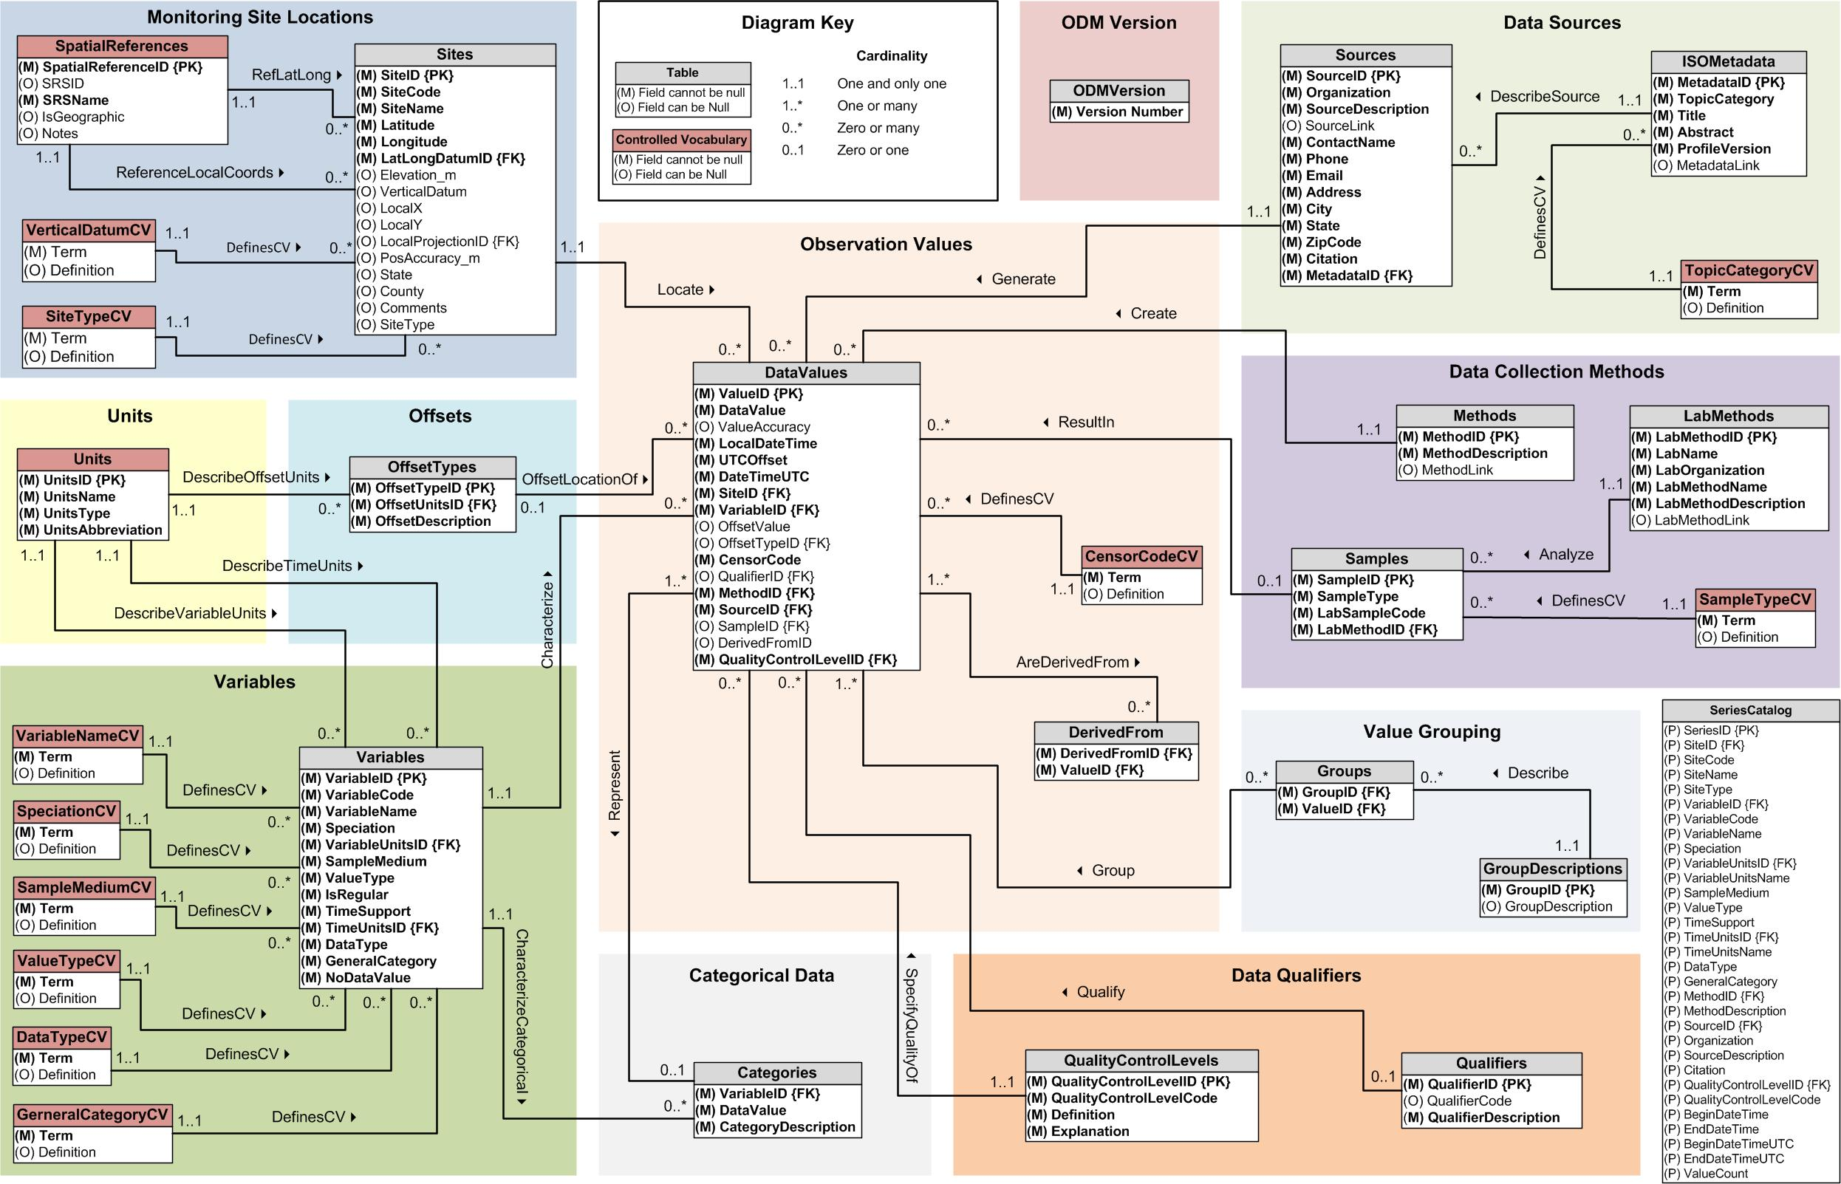
ODM 1.1.1

Slide 8
What are the basic attributes to be associated with each single data value and how can these best be organized?
DateTime
Interval (support)
“When”
Time, T
Units
Accuracy
Censoring
Qualifying comments
t
A data value
v_{i} (s,t)
Variable
Method
Quality Control Level
Sample Medium
Value Type
Data Type
Source/Organization
“Where”
s
Space, S
V_{i}
Location
Feature of interest
“What”
Variables, V

Slide 9
Data Series – Metadata Description
Time
There are C measurements of Variable V_{i} at Site S_{j} from time t₁ to time t₂
End Date Time, t₂
Count, C
Begin Date Time, t₁
Site, S_{j}
Space
Variable, V_{i}
Variables

Slide 10
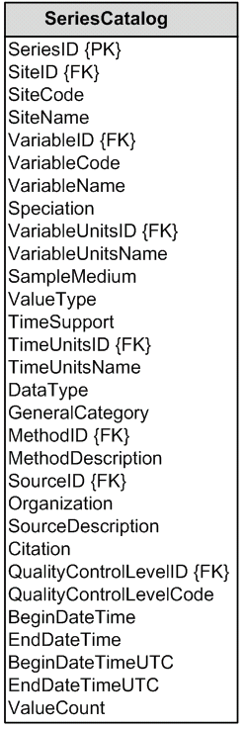
Series Catalog
S_{j}
Time
V_{i}
End Date Time, t₂
Count, C
Begin Date Time, t₁
Site, S_{j}
Space
Variable, V_{i}
t₁
Variables
t₂
C

Slide 11

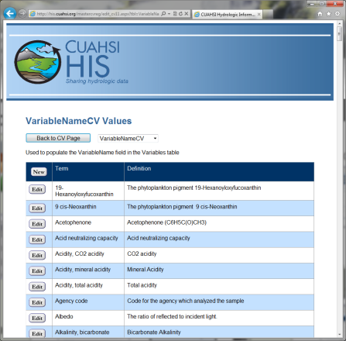

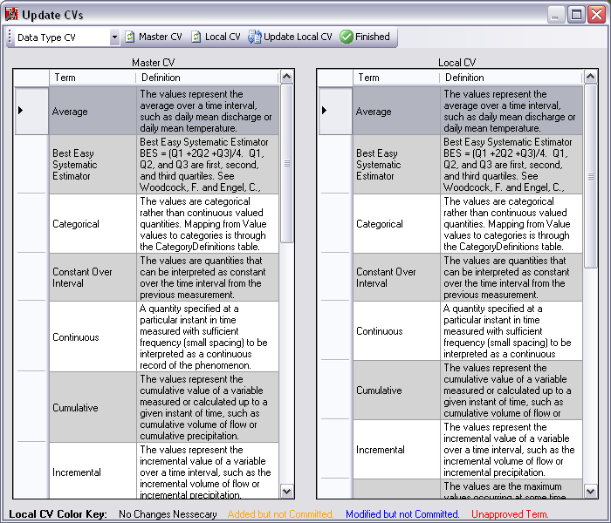
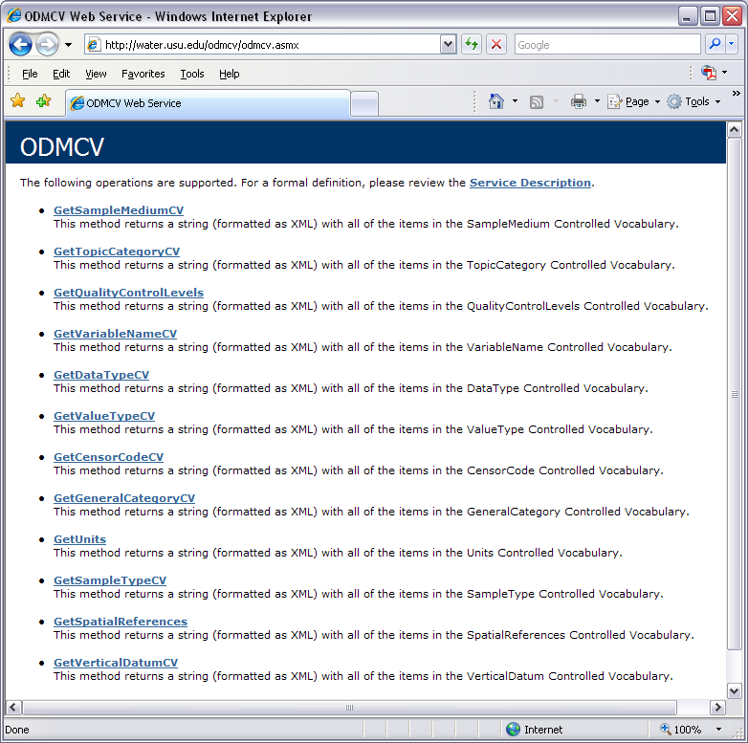
ODM Controlled Vocabularies
HIS CV Website
ODM Data Manager
ODM
Tools
ODM Controlled
Vocabulary Moderator
XML
Master ODM Controlled Vocabulary
Local ODM
Database
ODM
Controlled Vocabulary
Web Services
Local
HydroServer

Slide 12
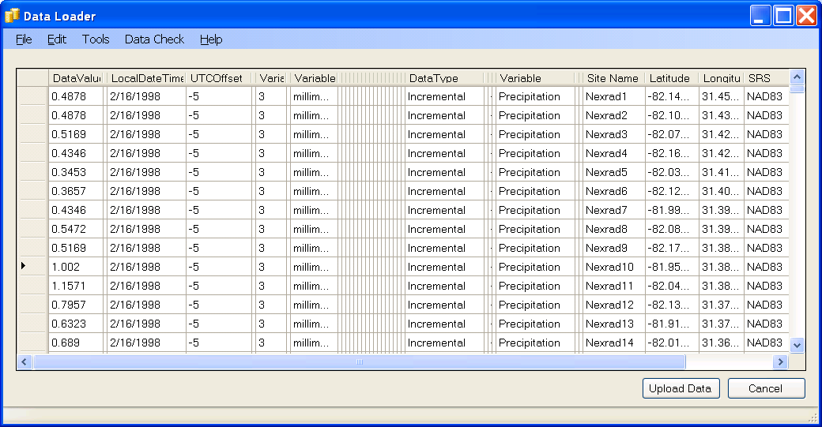
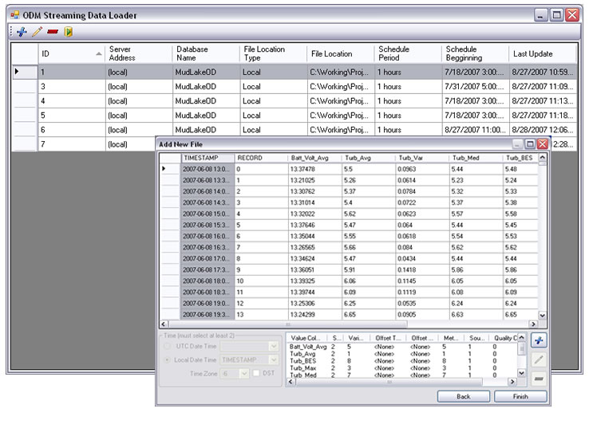
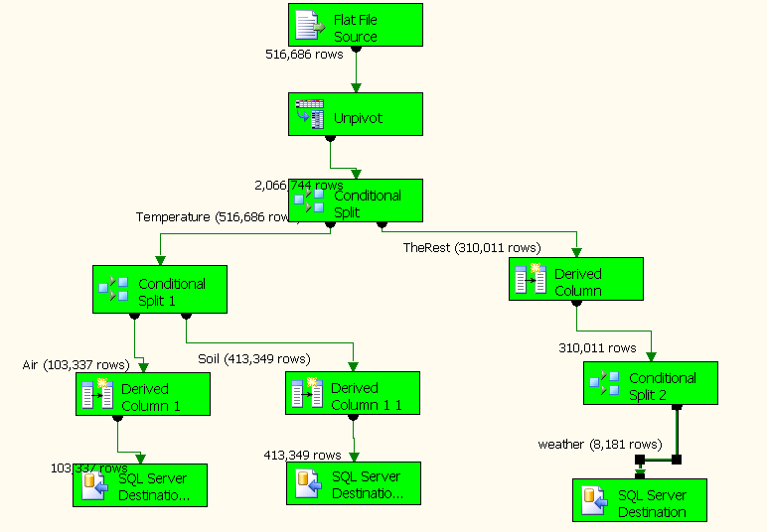
Loading Data into ODM
ODM Data Loader
Interactive ODM Data Loader
Loads data from spreadsheets and comma separated tables in simple format
Streaming Data Loader (SDL)
Loads data from datalogger files on a prescribed schedule
Interactive configuration
SQL Server Integration Services (SSIS)
Microsoft application accompanying SQL Server useful for programming complex loading or data management functions
ODM SDL
SSIS

Slide 13
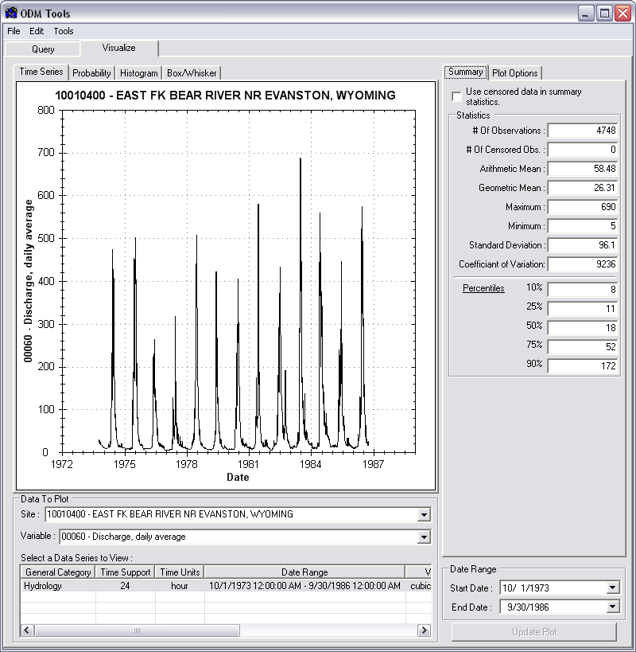
Managing Data Within ODM - ODM Tools
Query and export – export data series and metadata
Visualize – plot and summarize data series
Edit – delete, modify, adjust, interpolate, average, etc.

Slide 14
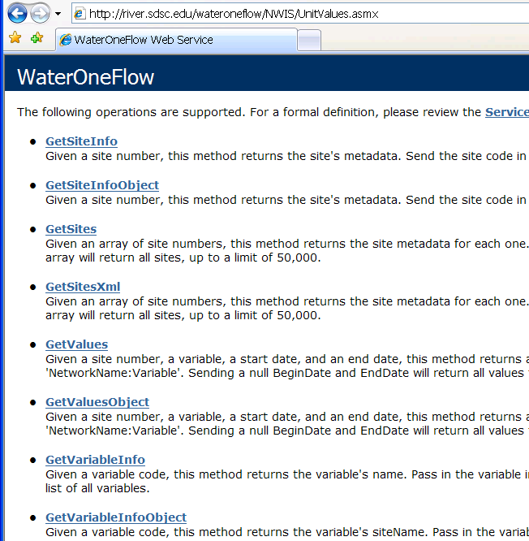
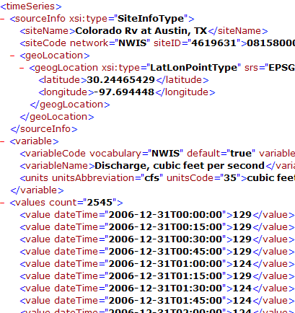
Publishing Data in an ODM Database
WaterML and WaterOneFlow
WaterML is an XML schema for communicating water data
WaterOneFlow is a set of web services based on WaterML
Set of query functions
Returns data in WaterML
Slide from David Valentine
Notes:
14

Slide 15
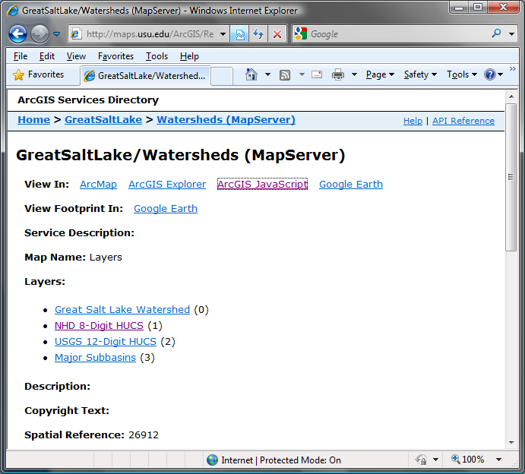
Publication of Geospatial (GIS) Datasets
Publishing spatial datasets using ArcGIS Server
Using OGC standards that can be consumed by a number of GIS clients
WMS, WFS, WCS

Slide 16
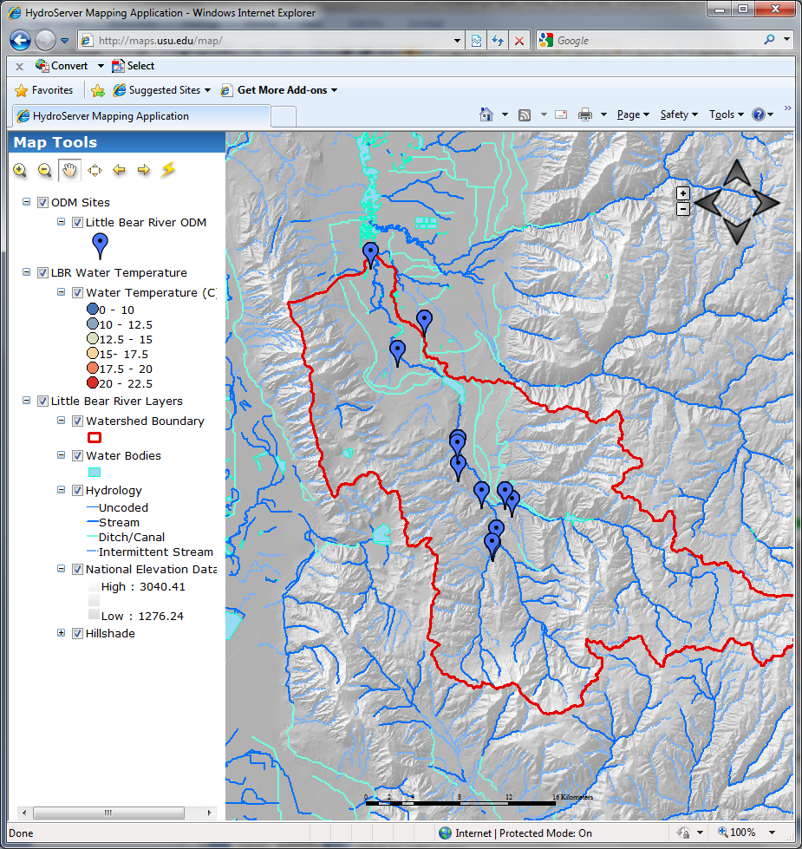
Data Presentation Via a Map Interface
Internet Map Server built using ArcGIS
Web browser client
Combine spatial data and observational data
Launch data visualization tools
Based on a “Region”
http://maps.usu.edu/map/

Slide 17
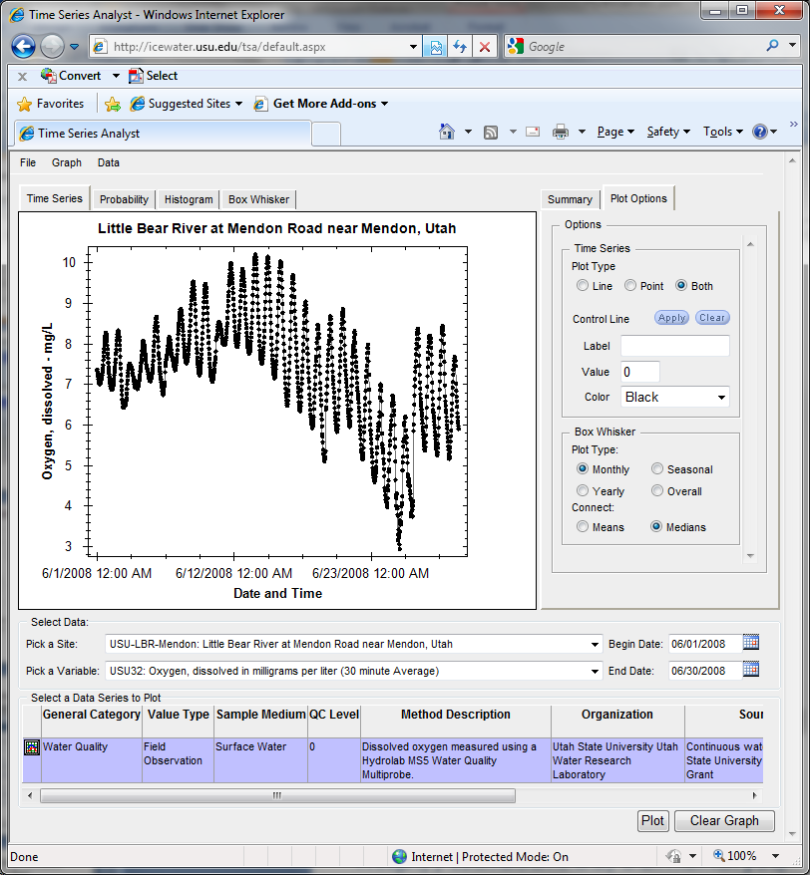
Data Preview, Visualization, and Analysis Time Series Analyst
Web Browser Client
Multiple ODM Database Support
Variety of plot types
Descriptive statistics
Linked to the map application
Data preview and download
http://icewater.usu.edu/tsa/

Slide 18
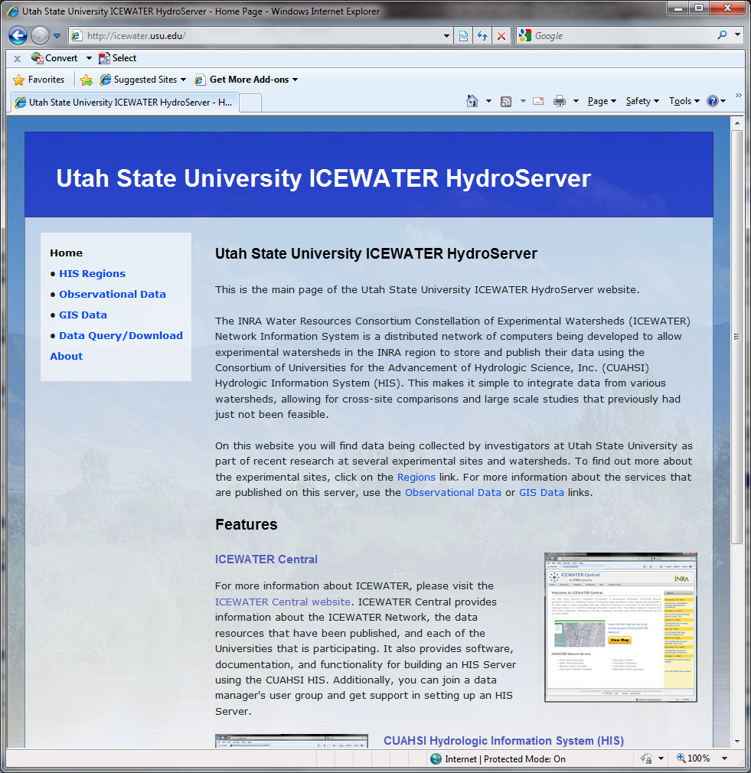
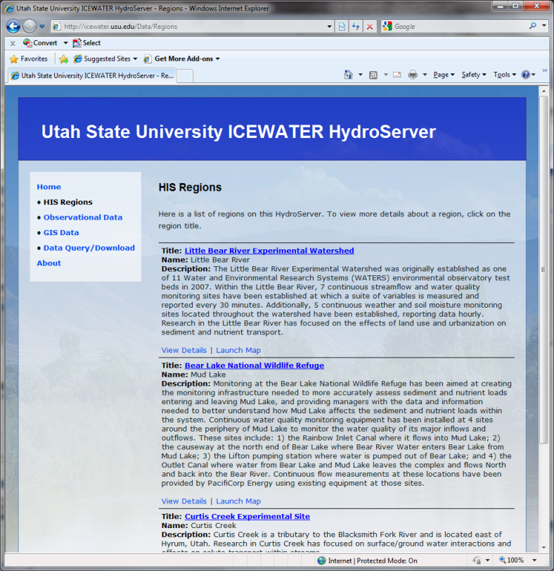
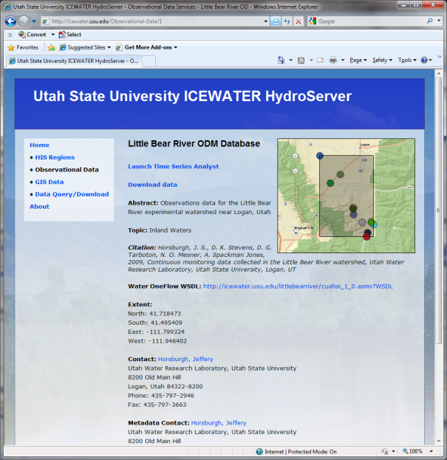
HydroServer Website
HydroServer home page
Observational data services
GIS data services
Online map
Time Series Analyst
Data Query and Download
http://icewater.usu.edu

Slide 19
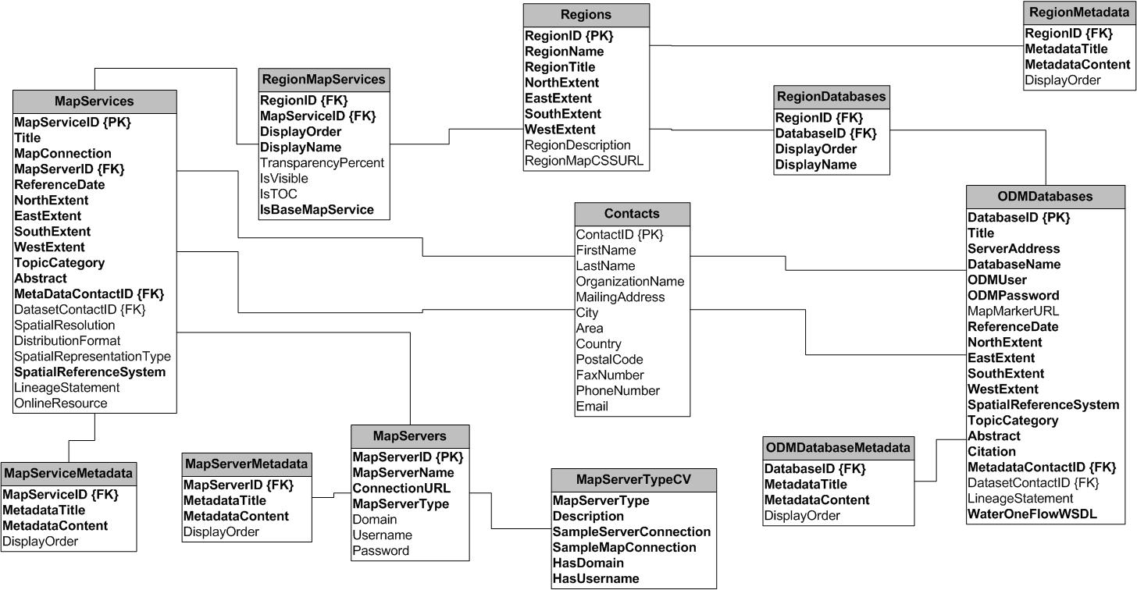
HydroServer Capabilities Database
HydroServer Capabilities Database Configuration Tool
Simple Windows application for creating metadata records in your database
Associating Regions with services and maps

Slide 20
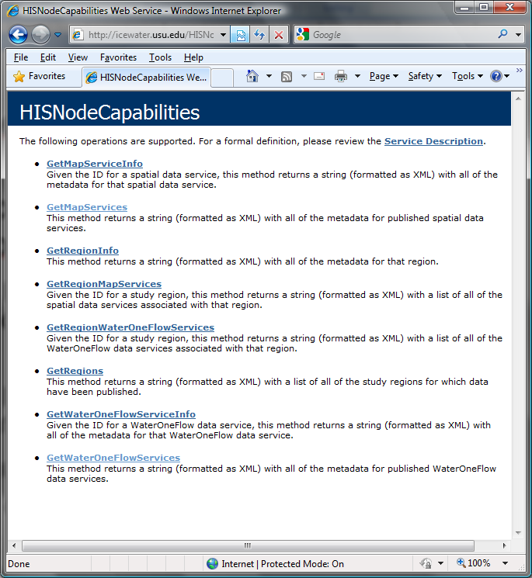
HydroServer Capabilities Web Service
Publish capabilities of each HydroServer
Listing of published observational data services
Listing of published spatial data services
Supports automatic cataloging of available services at HIS Central
Makes HydroServers self describing
Catalog
Metadata Services
Catalog Services
Server
Data Services
Desktop

Slide 21
Summary
HydroServer provides a self contained autonomous data publication system
Local control of data, but universally accessible
Downloadable user (data publisher) configurable software stack that contains:
ODM and associated tools
WaterOneFlow web services
Geographic data sharing using WFS, WCS, WMS from ArcGIS server
Time Series Analyst
ArcGIS server based web map application
HydroServer Capabilities web service that publishes metadata about regions and services (observational and spatial)

Slide 22
Questions?
CUAHSI
HIS
Sharing hydrologic data
http://his.cuahsi.org/
Support
EAR 0622374

